Slide 1
Today
Lecture 13: Quasiparticle tunneling --- special tunneling effects and applications
Discussion of quasiparticle tunneling in two parts:
Theory
Special tunneling effects and applications
Next time
Lecture 14: Josephson tunneling --- theory and phenomena

Slide 2
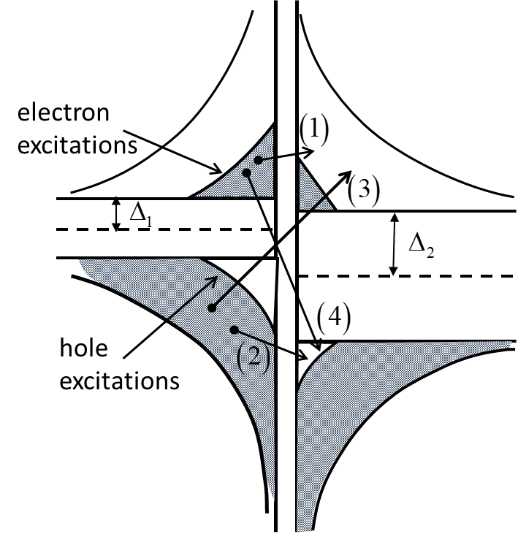
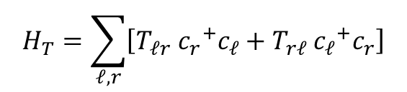


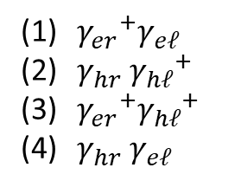



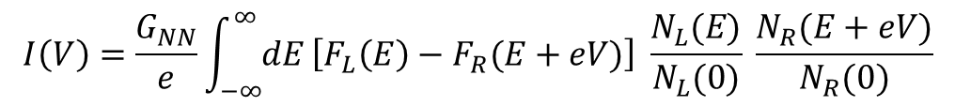

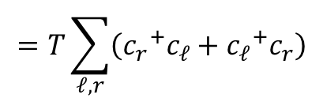
Last time
Wrote down the tunneling Hamiltonian:
$$H_{T}=\sum_{ℓ,r}{\left[T_{ℓr} {c_{r}}^{+}c_{ℓ}+T_{rℓ} {c_{ℓ}}^{+}c_{r}\right]}$$
$$=T\sum_{ℓ,r}{\left({c_{r}}^{+}c_{ℓ}+{c_{ℓ}}^{+}c_{r}\right)}$$
Introduced the Josephson operators :
$${γ_{ek0}}^{+}=u_{k}{c_{k↑}}^{+}−v_{k }S^{+ }c_{−k↓}$$
$${γ_{hk0}}^{+}=u_{k} S{{ c}_{k↑}}^{+}−v_{k}c_{−k↓}$$
$${c_{k↑}}^{+}=u_{k}{γ_{ek0}}^{+}+v_{k}γ_{hk1}$$
$${γ_{ek1}}^{+}=u_{k}c^{+}+v_{k }S^{+}{ c}_{k↑}$$
$${c_{−k↓}}^{+}=u_{k}{γ_{ek1}}^{+}−v_{k}γ_{hk0}$$
$${γ_{hk1}}^{+}=u_{k} S{{ c}_{−k↓}}^{+}+v_{k}c_{k↑}$$
Calculated the tunneling current that gave us the “semiconductor model”:
$$I\left(V\right)=\frac{G_{NN}}{e}\int_{−∞}^{∞}{dE}\left[F_{L}\left(E\right)−F_{R}(E+eV)\right] \frac{N_{L}(E)}{N_{L}(0)} \frac{N_{R}(E+eV)}{N_{R}(0)}$$
${γ_{er}}^{+}γ_{eℓ}$
$γ_{hr}{{ γ}_{hℓ}}^{+}$
${γ_{er}}^{+}{γ_{hℓ}}^{+}$
$γ_{hr}{ γ}_{eℓ}$

Slide 3
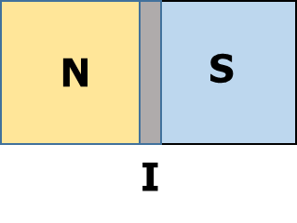
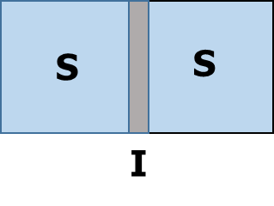
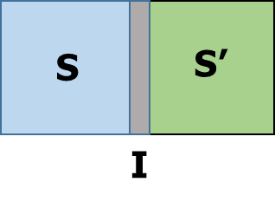
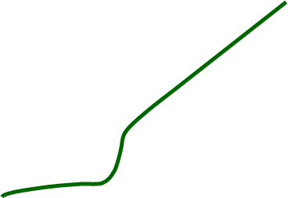








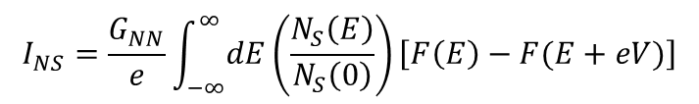



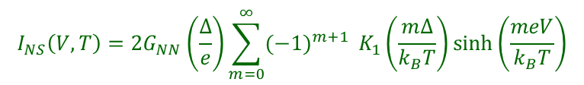
$$I_{NS}\left(V,T\right)=2G_{NN}\left(\frac{∆}{e}\right)\sum_{m=0}^{∞}{{(−1)}^{m+1}} K_{1}\left(\frac{m∆}{k_{B}T}\right)\sinh\left(\frac{meV}{k_{B}T}\right)$$
NIS Tunneling
$$Tc>T>0$$
$$I_{NS}=\frac{G_{NN}}{e}\int_{−∞}^{∞}{dE}\left(\frac{N_{S}\left(E\right)}{N_{S}\left(0\right)}\right)\left[F\left(E\right)−F(E+eV)\right]$$
$$I_{NS}\left(V\right)=$$
$$\frac{G_{NN}}{e}$$
$\sqrt{{(eV)}^{2}−∆^{2}}$
$$T=0$$
SIS’ Tunneling
$$I_{SS}′=\frac{G_{NN}′}{e}\int_{−∞}^{∞}{dE}\left(\frac{N_{S}(E)}{N_{S}(0)}\right)\left(\frac{N_{S}′(E+eV)}{N_{S}′(0)}\right)\left[F\left(E\right)−F(E+eV)\right]$$
$T>Tc$
$$Tc>T>0$$
$T>Tc$
$$Tc>T>0$$
$$T=0$$
$$T=0$$
$$\frac{G_{NN}}{e}\left[\left(2∆+eV\right)E\left(α\right)−\frac{4∆\left(∆+eV\right)}{2∆+eV} K(α)\right]$$
$$I_{SS}(V)=$$

Slide 4

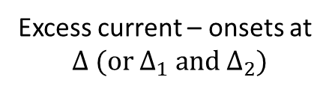
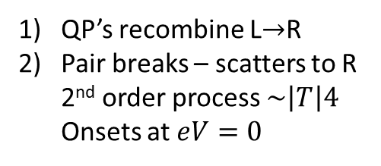

Special Tunneling effects
(1) Multi-particle tunneling
Excess current – onsets at
$$∆ (or ∆_{1} and ∆_{2})$$
QP’s recombine L→R
Pair breaks – scatters to R 2nd order process $\sim \left|T\right|4$ Onsets at $eV=0$
Onsets at $eV=∆_{1}$
Onsets at $eV=∆_{2}$

Slide 5
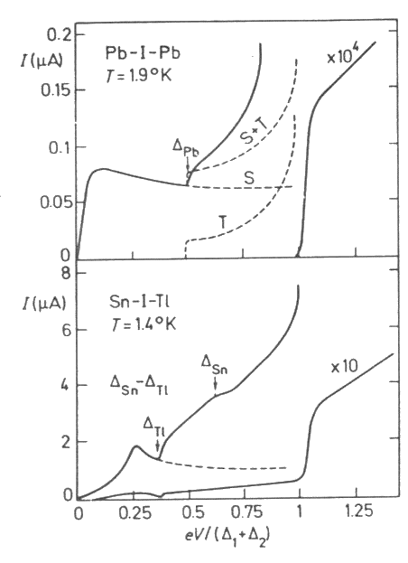
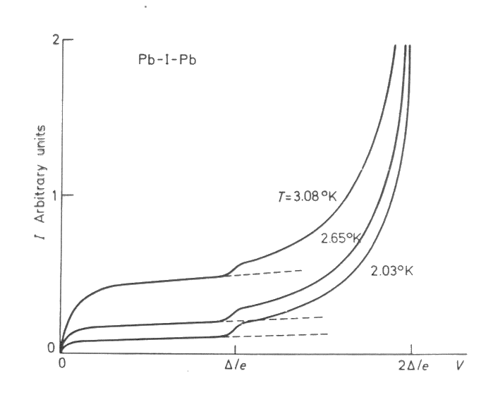

Slide 6

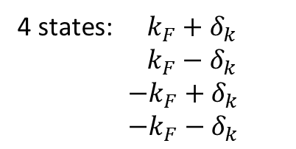
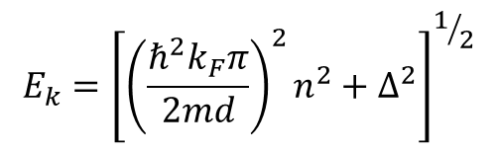
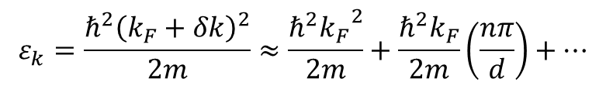



(2) Geometric resonances
Tomasch effect
Effect enhanced by taking the second-derivative of the voltage
$$2d=nλ=n\left(\frac{2π}{δk}\right)$$
Resonance:
$$δk=\frac{nπ}{d}$$
4 states: $k_{F}+δ_{k}$
$k_{F}−δ_{k}$
$−k_{F}+δ_{k}$
$−k_{F}−δ_{k}$
$$ε_{k}=\frac{ℏ^{2}{\left(k_{F}+δk\right)}^{2}}{2m}≈\frac{ℏ^{2}{k_{F}}^{2}}{2m}+\frac{ℏ^{2}k_{F}}{2m}\left(\frac{nπ}{d}\right)+…$$
$$E_{k}={\left[{\left(\frac{ℏ^{2}k_{F}π}{2md}\right)}^{2}n^{2}+∆^{2}\right]}^{1/2}$$
Interference ⇒ standing waves
$$ψ\sim \cos{k_{F}x }\sin\left(δk\right)x$$
$N_{S}\left(E\right)$shows peaks at the above values ⇒
modulated currents

Slide 7


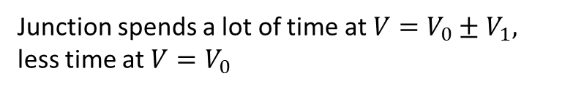
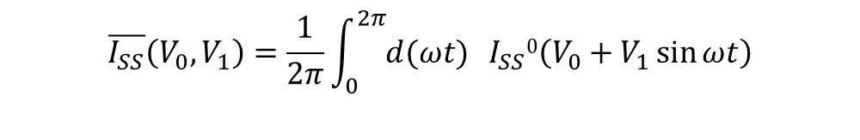

(3) Photon (or phonon) assisted tunneling
Apply microwaves to a tunnel junction.
Oscillates the electromagnetic potential of one side relative to other.
Classical treatment:
Assume an I-V characteristic for a tunnel junction:
$$I_{SS}0\left(V\right)$$
Apply a dc + ac voltage:
$$V\left(t\right)=V_{0}+V_{1}\sin{ωt}$$
$I_{SS}\left(t\right)=I_{SS}0\left(V\left(t\right)\right)$ $=I_{SS}0\left(V_{0}+V_{1}\sin{ωt}\right)$
$$\overline{I_{SS}}\left(V_{0}, V_{1}\right)=\frac{1}{2π}\int_{0}^{2π}{d(ωt)} I_{SS}0\left(V_{0}+V_{1}\sin{ωt}\right)$$
Calculate the phase-average:
Junction spends a lot of time at $V=V_{0}±V_{1},$
less time at $V=V_{0}$
Splitting of peaks: $\left(∆_{1}±∆_{2}\right)±eV_{1}$

Slide 8






Quantum treatment:
CASE I
$$ℏω>2∆$$
Break Cooper pairs ⟹ more qp’s ⟹ enhanced tunneling current (like heating)
CASE II $ℏω<2∆$
Cannot break pairs
(a) Can raise energy of qp’s ⟹ small effects (raise energy gap, for example)
(b) Can “assist” in qp tunneling by altering energy conservative conditions
Absorption
Emission
$$E_{L}+ℏω=E_{R}$$
$$E_{L}=ℏω+E_{R}$$
Threshold: $eV>\left(∆_{1}+∆_{2}\right)−ℏω$
$$eV>\left(∆_{1}+∆_{2}\right)+ℏω$$
(Peak occurs due to density of states factor)

Slide 9

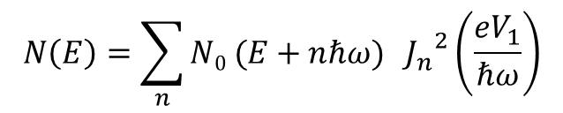
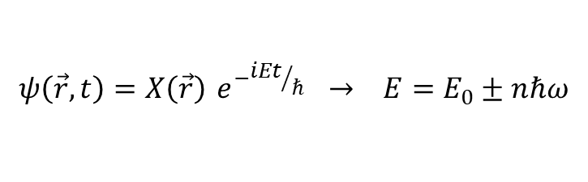





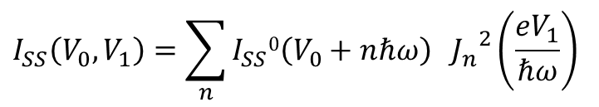
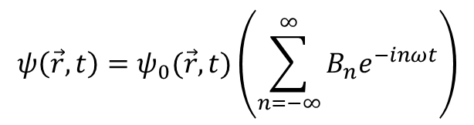
Consider $∆_{1}≠∆_{2}$, allow multiple absorptions/emissions ⟹ structure at : $\left(∆_{1}±∆_{2}\right)±nℏω$
Solution (Tien – Gordon)
$$H=H_{0}+H_{T}→H=H_{0}+H_{1}+H_{T}$$
$$eV_{1}\sin{ωt}$$
$$ψ\left(\vec{r},t\right)=X\left(\vec{r}\right){ e}^{−{iEt}/ℏ} → E=E_{0}±nℏω$$
spatial
time dependent
$$ψ\left(\vec{r},t\right)=ψ_{0}(\vec{r}, t)\left(\sum_{n=−∞}^{∞}{B_{n}e^{−inωt}}\right)$$
n photon processes
TDSE : $Hψ=iℏ\frac{∂ψ}{∂t}$
$$N\left(E\right)=\sum_{n}{{N0}_{ }(E+nℏω)} {J_{n}}^{2}\left(\frac{eV_{1}}{ℏω}\right)$$
Recursion relation ⟹ $2_{n}B_{n}=\left(\frac{eV_{1}}{ℏω}\right)\left(B_{n+1}−B_{n−1}\right)$
Bessel function (1st Kind): $B_{n}=J_{n}\left(\frac{eV_{1}}{ℏω}\right)$
$$I_{SS}\left(V_{0}, V_{1}\right)=\sum_{n}{I_{SS}0\left(V_{0}+nℏω\right)} {J_{n}}^{2}\left(\frac{eV_{1}}{ℏω}\right)$$
Probability $\sim {\left|B_{n}\right|}^{2} \sim {J_{n}}^{2}$

Slide 10



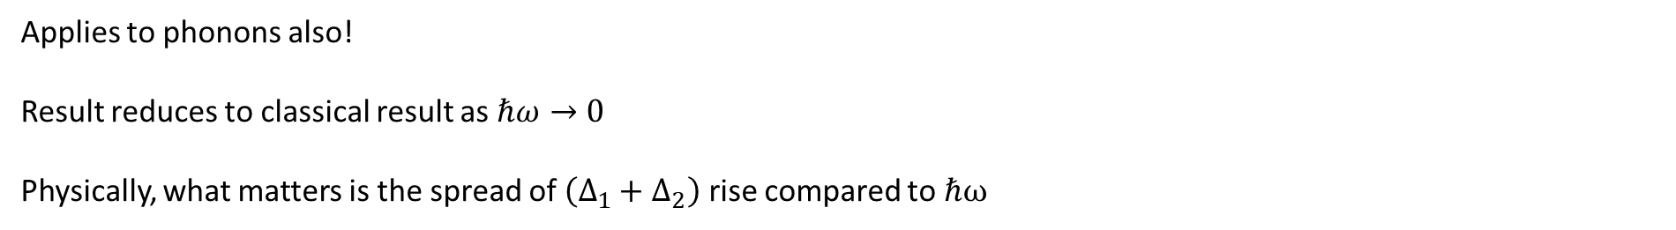



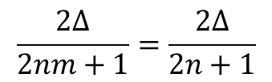
Comments:
Applies to phonons also!
Result reduces to classical result as $ℏω→0$
Physically, what matters is the spread of $\left(∆_{1}+∆_{2}\right)$ rise compared to ℏω
This gives structure in the quasiparticle tunneling IV’s --- we will see something similar but different in the Josephson supercurrent (Shapiro steps)
(4) Subharmonic structure
$$\left(\frac{2eV}{ℏ}\right)m$$
Josephson oscillations: $ω_{m}=$
(harmonics)
(a) Photon-assisted tunneling : $eV=2∆−nℏω=2∆−nm\left(2eV\right)$
$eV=$
$$\frac{2∆}{2nm+1}=\frac{2∆}{2n+1}$$
(odd harmonics)
(b) If $ℏω_{n}>2∆,$ absorption ⟹ structure at $eV=$
$$\frac{2∆}{2n}$$
(even harmonics)
Peak to $n=12$ have been reported.

Slide 11
Tunneling Applications
density of states
quasiparticle distribution
in thermal equilibrium
Tunneling – probe of
measures relative to normal state which contains matrix elements
confirmation of BCS model and energy gap
*Ideal BCS behavior rarely seen ⟹ deviations both intrinsic and caused by perturbation are the most
  interesting and valuable as a probe
Topics:
(1) Pairbreaking mechanisms
(2) Strong-coupling effects
(3) Special tunneling effects
(4) non-equilibrium effects & devices
(a) qp ⟹ SC transistor
(b) phonons ⟹ generators, detectors
(c) photons ⟹ qp mixers
(5) pairing symmetry – gap anisotropy

Slide 12

(1) Pairbreaking mechanisms – “break time-reversal symmetry of pairs”
Anderson (1959) – extension of BCS to dirty systems $\left(ℓ<ξ_{0}\right)$
$\vec{k}$ not a good quantum number due to rapid scattering
self-consistent field method generalized to pairing between time-reversed states
Dirty (impurities) ⟹ BCS same $T_{c}, N_{S}\left(E\right), ∆$ (elastic scattering) ---- Anderson theorem
Abrikosov-Gorkov (1960):
Magnetic impurities
⟹
dephase pairs (break phase coherence) and destroy time reversal symmetry
⟹ finite lifetime pairs
⟹ smear $N_{s}(E)$
Maki-deGennes (1964)
Generalized to other situations where there is rapid scattering (e.g. dirty SC)

Slide 13



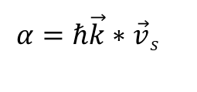



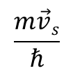


“Pairbreaking mechanisms”
magnetic impurities
magnetic field
Supercurrent flow
Spin exchange & hyperfine fields
Order parameter spatial gradients (NS)
Small samples
Inelastic scattering
Characterize pair-breaking by 2α : energy difference between time-reversed states
$$E_{k}$$
$$E_{k}^{′}=E_{k}±α$$
$$\frac{m\vec{v}s}{ℏ}$$
We saw this before: current-carrying SC --- all electrons shifted by $\vec{k_{s}}=$
$$k$$
$$\vec{v}s$$
Pairing between $\left(−\vec{k}+\vec{k_{s}}, +\vec{k}+\vec{k_{s}}\right)$
$$E_{k}→E_{k}^{′}=E_{k}±ℏ\vec{k}∗\vec{v_{S}}$$
$$α=ℏ\vec{k}∗\vec{v}s$$
$$\frac{ℏ}{τ_{k}}$$
Lifetime : $\sim 2α$ (deGennes)
time for time-reversed states to diphase (destroy phase coherence)

Slide 14
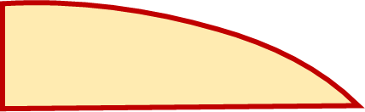

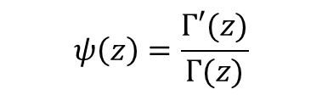
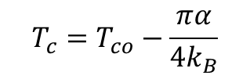

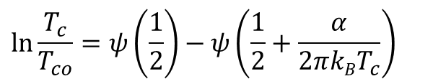




$$\ln{\frac{T_{c}}{T_{co}}=ψ\left(\frac{1}{2}\right)−ψ\left(\frac{1}{2}+\frac{α}{2πkBT_{c}}\right)}$$
(1) Reduced $T_{c}$ :
$$T_{c}=T_{co}−\frac{πα}{4k_{B}}$$
linear
$$ψ\left(z\right)=\frac{Γ′(z)}{Γ(z)}$$
digamma function
$$α$$
(2) Reduced pair potential
$$∆(0)$$
Detected by tunneling spectoscopy
(3) Reduced quasiparticle energy gap $E_{g}(0)$
increasing
Since $E_{k}^{′}=E_{k}±α$
gapless for $α>Δ(T)$
gapless
everywhere
gapless
SC

Slide 15
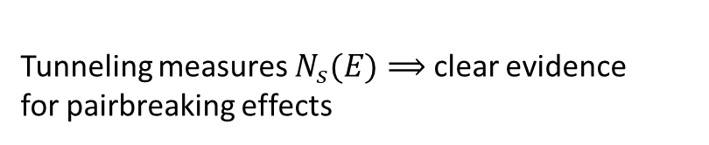



Effect of pairbreaking on the density of states
Effect of pairbreaking on
linear
increasing
Area (# states) conserved
Gapless SC occurs – still SC ($E_{g}$ not responsible)
Peak washes out
$$E_{g}<2∆ ⟹$$
Tunneling measures $N_{s}(E)⟹$ clear evidence
for pairbreaking effects
“states in gap”
Gapless for $α>∆$

Slide 16
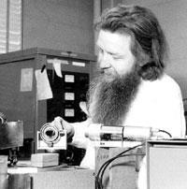
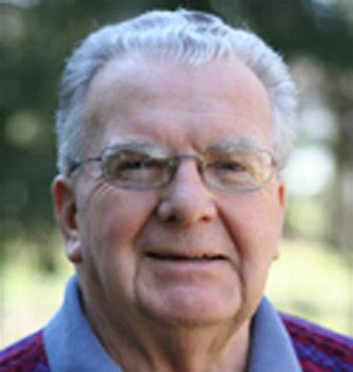


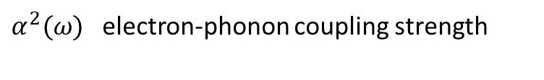
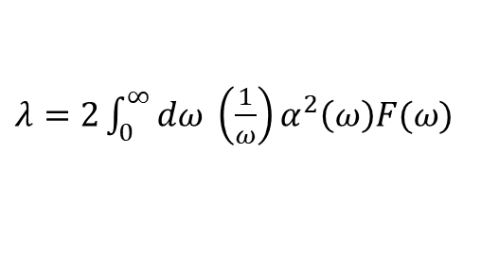


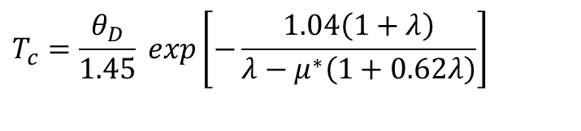


Strong-coupling (“bad actor SC”) – details of electron-phonon coupling important
$∆k$ is complex and energy-dependent
excitation energies
decay of qp excitations with the emission of phonons
Theory --- Eliashberg gap equation (1960)
considered the retarded nature of electron-phonon coupling (not in BCS)
Results --- phonon modes $⟺ N_{S}\left(E\right)$ variations
$$μ^{∗}$$
Coulomb pseudo-potential (repulsive interaction)
TWO PARAMETERS
$α^{2}F(ω)$ electron-phonon (attractive interaction)
$α^{2}(ω)$ electron-phonon coupling strength
$$F(ω)$$
phonon density of states
McMillan Conversion Procedure
Bill McMillan
John Rowell
$μ^{∗}, α^{2}F↔N_{S}(E)$
iterative solution (vary $μ^{∗}, α^{2}F$)
$$T_{c}=\frac{θ_{D}}{1.45} exp\left[−\frac{1.04\left(1+λ\right)}{λ−μ^{∗}\left(1+0.62λ\right)}\right]$$
Experiments (Rowell & McMillan) ⟶ excellent agreement with known phonon data and fits to tunneling data
where
$λ=2\int_{0}^{∞}{dω} \left(\frac{1}{ω}\right)α^{2}\left(ω\right)F(ω)$

Slide 17
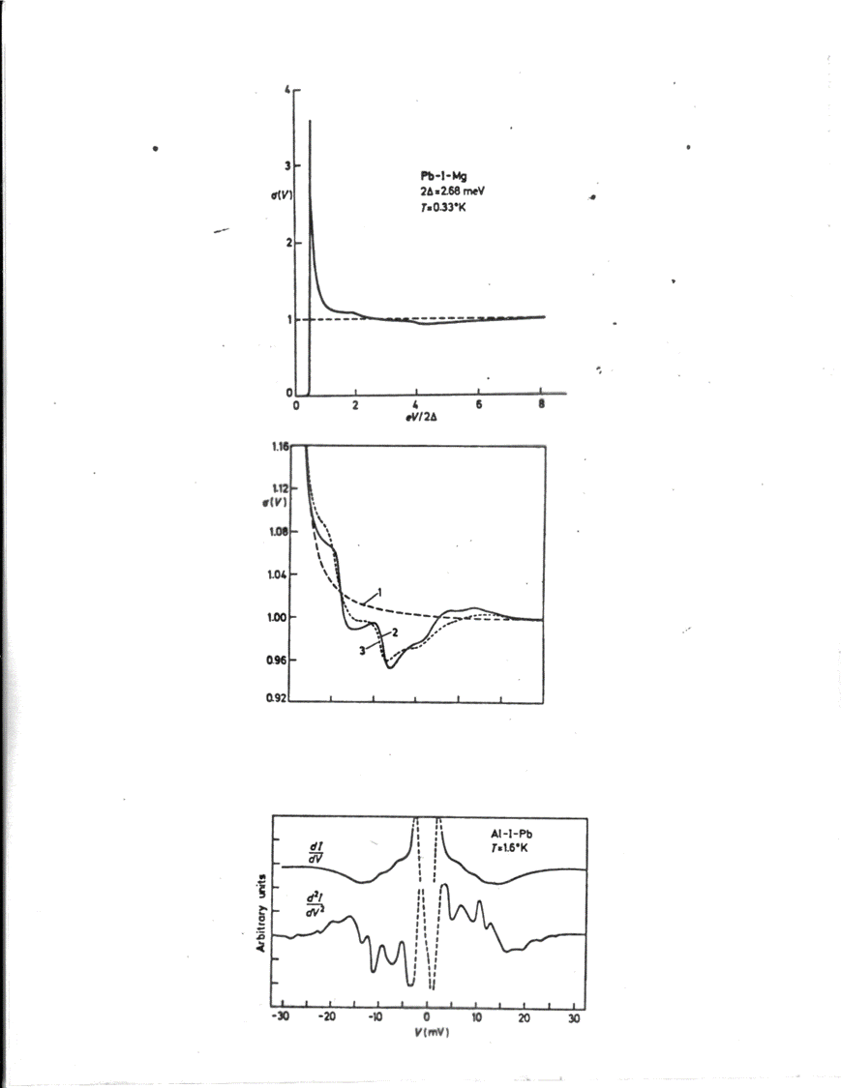


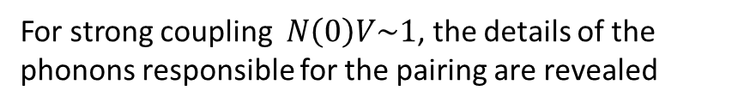
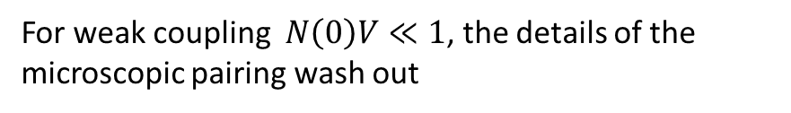
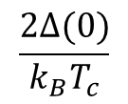

Strong-coupling SC
$$\frac{2∆(0)}{k_{B}T_{c}}$$
$$>3.53$$
For weak coupling $N\left(0\right)V≪1$, the details of the microscopic pairing wash out
Some superconductors
Pb ~ 4.3, Nb ~ 4.8, Hg ~ 4.6, YBCO ~ 6
For strong coupling $N\left(0\right)V\sim 1$, the details of the phonons responsible for the pairing are revealed
Structure in tunneling (for $eV≫∆$)
Structure near $kθ_{D}$(phonon frequencies)

Slide 18
Unconventional superconductivity Modeling tunneling spectra
Γ = broadening parameter to account for inhomogeneities and fluctuations
“s-wave”
+
_
_
+
“d-wave”

Slide 19
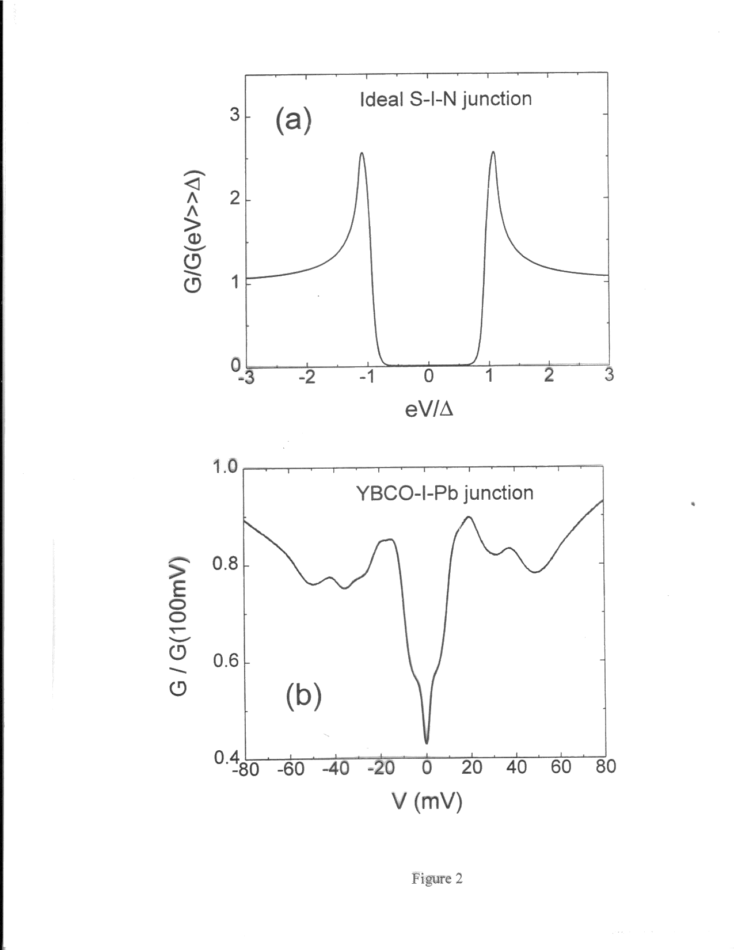
Energy gap measurements

